Slide 1
Inter-Computer Communications (Networking One)
Week 5
Part 1 data communications

Slide 2
Questions
What is Data Communication?
How the data communications and networking are changing the way we do business?
How the businesses rely extensively on computer networks and internetworks.
What is meant by Network topologies and differentiate them?
How is it possible for communications links to carry more and faster signals.

Slide 3
Data Communication
The term telecommunication means communication at a distance. The word data refers to information presented in whatever form is agreed upon by the parties creating and using the data. Data communications are the exchange of data between two devices via some form of transmission medium such as a wire cable.
For data communications to occur, the communicating devices must be part of a communication system made up of a combination of hardware (physical equipment) and software (programs).

Slide 4
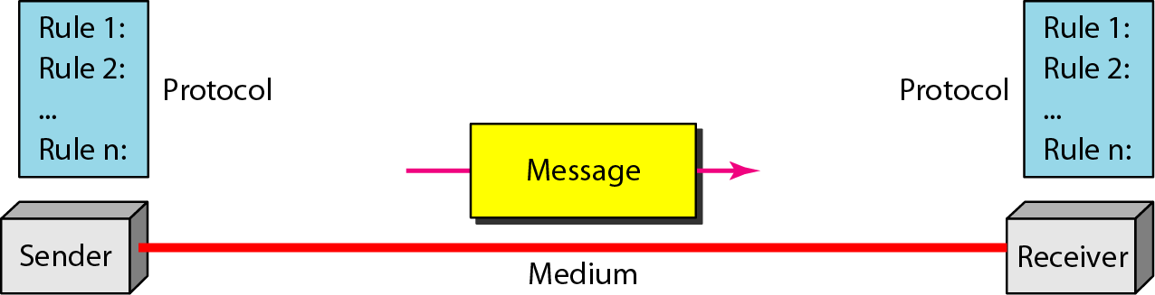
Components of a
Data Communication System
Message
Sender
Receiver
Transmission Media
Protocol
Message: The message is the information (data) to be communicated. Popular forms of information include text, numbers, pictures, audio, and video.
Sender: The sender is the device that sends the data message. It can be a computer, workstation, telephone handset, video camera, and so on.

Slide 5
Components of a
Data Communication System
Receiver: The receiver is the device that receives the message. It can be a computer, workstation, telephone handset, television, and so on.
Transmission Medium: The transmission medium is the physical path by which a message travels from sender to receiver. Some examples of transmission media include twisted-pair wire, coaxial cable, fiber-optic cable, and radio waves.
Protocol: A protocol is a set of rules that govern data communications. It represents an agreement between the communicating devices. Without a protocol, two devices may be connected but not communicating, just as a person speaking French cannot be understood by a person who speaks only Japanese.

Slide 6
Data Representation
Information today comes in different forms such as text, numbers, images, audio, and video.
Text: In data communications, the text is represented as a bit pattern, a sequence of bits. Different sets of bit patterns have been designed to represent text symbols. Each set is called a code, and the process of representing symbols is called coding. The American Standard Code for Information Interchange (ASCII), developed in the United States constitutes the first 127 characters in Unicode and is also referred to as Basic Latin.
http://www.asciitable.com/

Slide 7
Data Representation
Numbers: Numbers are also represented by bit patterns. However, the number is directly converted to a binary number to simplify mathematical operations.
Images: Images are also represented by bit patterns. In its simplest form, an image is composed of a matrix of pixels (picture elements), where each pixel (individual point of color) is a small dot. The size of the pixel depends on the resolution.
For example, an image can be divided into 1000 pixels or 10,000 pixels. In the second case, there is a better representation of the image (better resolution), but more memory is needed to store the image.

Slide 8
Data Representation
Audio: Audio refers to the recording or broadcasting of sound or music. Audio is by nature different from text, numbers, or images. It is continuous, not discrete. Even when we use a microphone to change voice or music to an electric signal, we create a continuous signal.
Video: Video refers to the recording or broadcasting of a picture or movie. Video can either be produced as a continuous entity (e.g., by a TV camera), or it can be a combination of images, each as a discrete entity, arranged to convey the idea of motion.

Slide 9
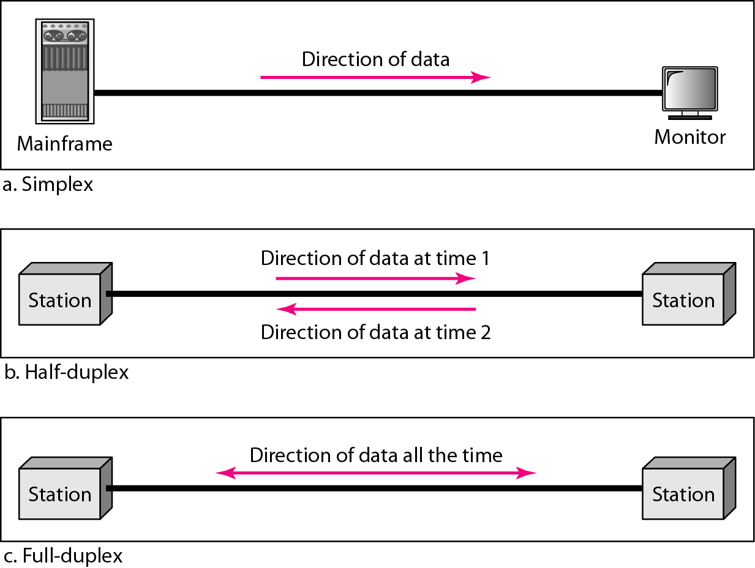
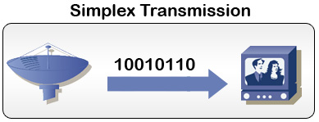
Data Flow
(Simplex, Half-duplex, and Full-duplex)
Simplex
In this mode, the communication is unidirectional, as on a one-way street. Only one of the two devices on a link can transmit; the other can only receive. Keyboards and traditional monitors are examples of simplex devices. The keyboard can only introduce input; the monitor can only accept output. The simplex mode can use the entire capacity of the channel to send data in one direction.

Slide 10
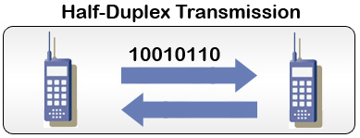
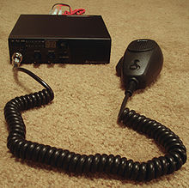
Data Flow
(simplex, half-duplex, and full-duplex)
Half-Duplex
In half-duplex mode, each station can both transmit and receive, but not at the same time.
When one device is sending, the other can only receive, and vice versa.
The half-duplex mode is like a one-lane road with traffic allowed in both directions.
When cars are travelling in one direction, cars going the other way must wait.
Walkie-talkies and CB (citizens band) radios are both half-duplex systems.
Notes:
Citizens Band Radio (also known as CB radio) is, in many countries, a system of short-distance radio communications between individuals typically on a selection of 40 channels within the 27 MHz (11 m) band.
In many countries, CB operation does not require a license, and (unlike amateur radio) it may be used for business or personal communications.

Slide 11
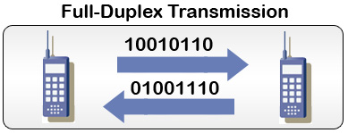
Data flow
(simplex, half-duplex, and full-duplex)
Full-Duplex
In full-duplex, both stations can transmit and receive data simultaneously.
The full-duplex mode is like a two-way street with traffic flowing in both directions at the same time.
One common example of full-duplex communication is the telephone network. When two people are communicating by a telephone line, both can talk and listen at the same time.

Slide 12


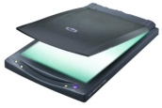
Networks
A Network is a set of devices (often referred to as Nodes) connected by communication links.
A node can be a computer, printer, or any other device capable of sending and/or receiving data generated by other nodes on the network.
A link can be a cable, air, optical fiber, or any medium which can transport a signal carrying information.
Node
Link
Link
Node
Node

Slide 13
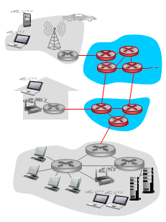
Computer Network
A computer network simply referred to as a network, is a collection of hardware components, which are interconnected by communication channels that allow sharing of resources and information with respect to certain set of rules / protocols via OS / software.
Elements of Network
Hardware equipments
Network OS / software
Communication channel
Information / Data
Protocols

Slide 14
Network Criteria
Performance
The performance of a network depends on a number of factors, including the number of users, the type of transmission medium, the capabilities of the connected hardware, and the efficiency of the software.
Performance is often evaluated by two networking metrics: THROUGHPUT and DELAY
More throughput and less delay are always preferred. These two criteria are contradictory. If we try to send more data to the network, we may increase throughput but the delay will rise also because of the traffic congestion in the network.
Network throughput is the rate of successful message delivery over a communication channel.

Slide 15
Network Criteria
Reliability
In addition to accuracy of delivery, the network reliability is measured by
Frequency of failure rate of network components
Measured in terms of availability/ robustness
Security
Data protection against corruption/ loss of data due to unauthorized access:
Errors
Malicious users

Slide 16
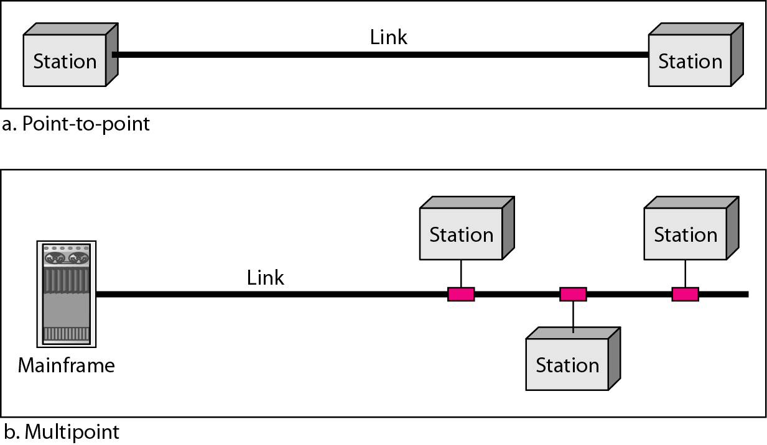
Physical Structures
Type of Connection
A network is two or more devices connected through links.
Point to Point - single transmitter and receiver
Multipoint - multiple recipients of single transmission
Types of connections:
point-to-point and multipoint

Slide 17

Physical Network Structures - Point-to-Point Connection
A point-to-point connection provides a dedicated link between two devices.
Most point-to-point connections use an actual length of wire or cable to connect the two ends, but other options, such as microwave or satellite links, are also possible.
When we change television channels by infrared remote control, a point-to-point connection is established between the remote control and the television’s control system.

Slide 18
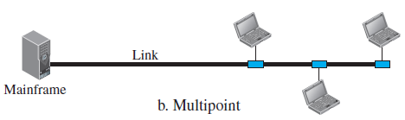
Physical Network Structures - Multipoint Connection
A multipoint (also called multidrop) connection is one in which more than two specific devices share a single link.
In the multipoint environment, the capacity of the channel is shared, either spatially or temporally.
If the several devices can use the link simultaneously, it is a spatially shared connection.
If users must take turns, it is a time shared connection.
Notes:
The term workstation has also been used to refer to everything from a mainframe computer terminal to a PC connected to a network, but the most common form refers to the group of hardware offered by several companies such as Sun Microsystems, Silicon Graphics, Apollo Computer, DEC, HP and IBM.

Slide 19
Physical Structures
Physical Topology
The term physical topology refers to the way in which a network is laid out (disburse) physically.
Two or more devices connect to a link; two or more links form a topology.
The topology of a network is the geometric representation of the relationship of all the links and linking devices (usually called nodes) to one another.

Slide 20
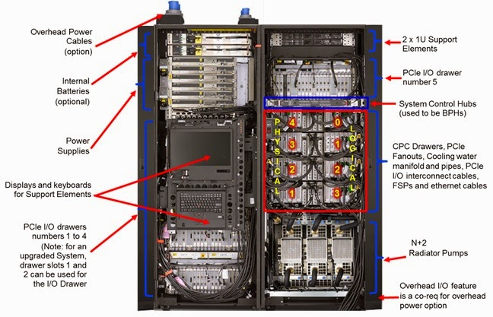
Distributed Processing Terminal Host Systems
Created in the 1960s
Central host computer does all the processing
Terminal is dumb along with a remote screen and keyboard
Largest hosts are mainframes
Example: IBM z Systems z13
Terminals
Host

Slide 21
Distributed Processing File Server Program Access
File Server Program Access is the Most Common Way to Execute Programs in PC Networks
Program files are stored on the file server
But downloaded (copied) to client PC for execution
Executed on client PC, not on file server
Example: File Transfer Protocol (FTP)
Executed
on
Client PC
Stored
on the
File
Server
Download
Client PC
File Server

Slide 22
Distributed Processing Client/Server Processing
Client and Server Machines
Neither has to be a PC (Although the client usually is)
Platform independence
Two programs: client and server programs
Example: browser and web server application program
Client
Program
Server
Program
Client Machine
Server

